Slide 1
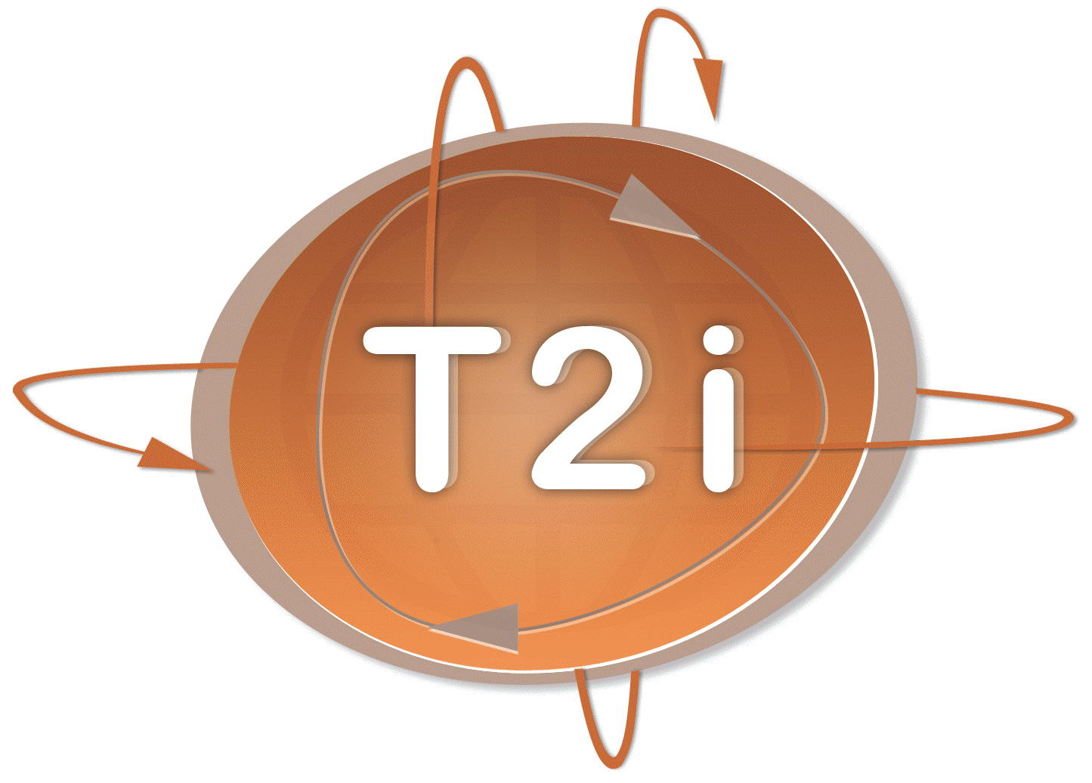
Network lifetime and stealth time of wireless video sensor intrusion detection systems under risk-based scheduling
ISWPC, 2011
Hong-Kong
Wednesday, February 23rd
Prof. Congduc Pham
http://www.univ-pau.fr/~cpham
Université de Pau, France
Notes:
My bio, the project…
Where to find the latest version of the slides in electronic format
Don’t hesitate to interrupt me
Break at 4pm

Slide 2
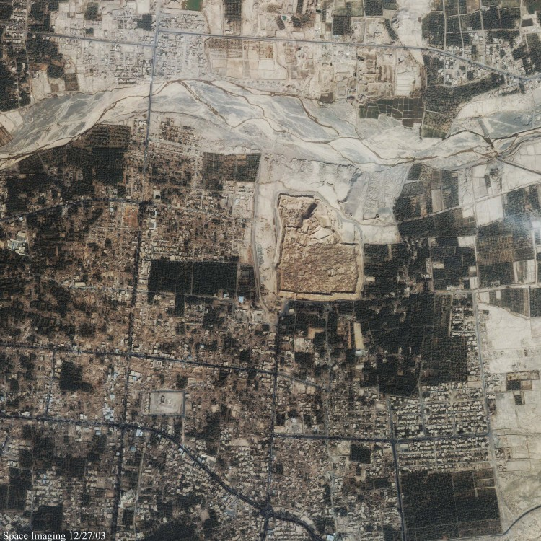
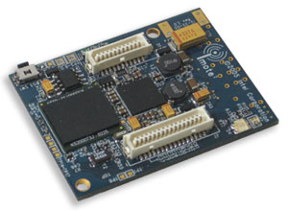
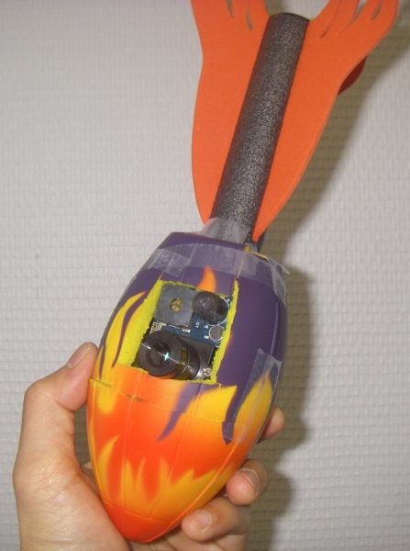
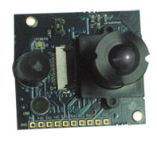
Wireless Video Sensors
Imote2
Multimedia board

Slide 3
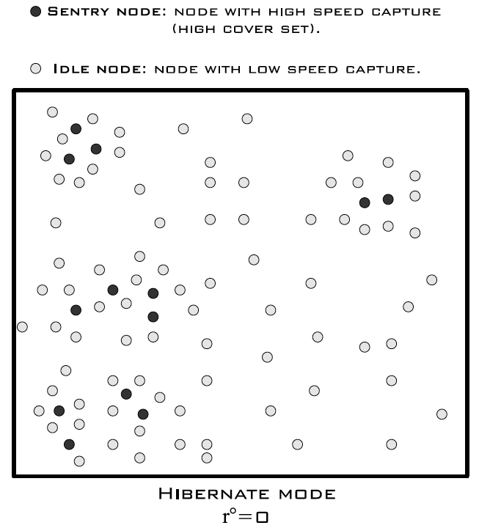
Surveillance scenario (1)
Randomly deployed video sensors
Not only barrier coverage but general intrusion detection
Most of the time, network in so-called hibernate mode
Most of active sensor nodes in idle mode with low capture speed
Sentry nodes with higher capture speed to quickly detect intrusions

Slide 4
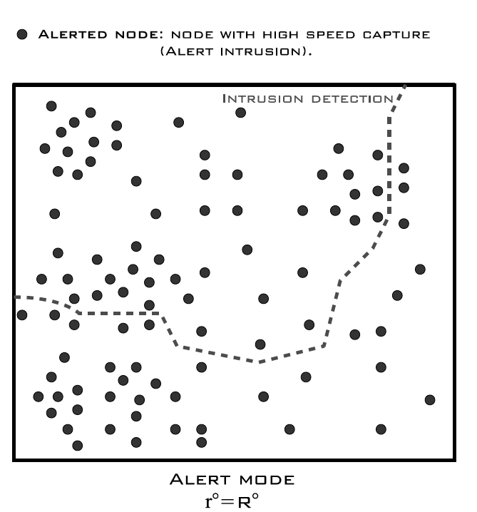
Surveillance scenario (2)
Nodes detecting intrusion must alert the rest of the network
1-hop to k-hop alert
Network in so-called alerted mode
Capture speed must be increased
Ressources should be focused on making tracking of intruders easier

Slide 5
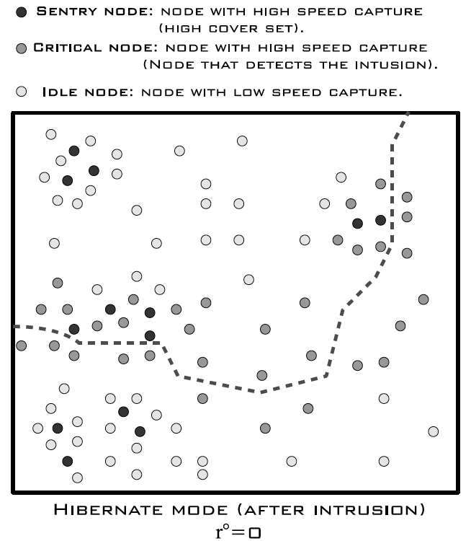
Surveillance scenario (3)
Network should go back to hibernate mode
Nodes on the intrusion path must keep a high capture speed
Sentry nodes with higher capture speed to quickly detect intrusions

Slide 6
Don’t miss important events!
Real scene
Whole understanding of the scene is wrong!!!
What is captured

Slide 7
How to meet surveillance app’s criticality
Capture speed can be a « quality » parameter
Capture speed for node v should depend on the app’s criticality and on the level of redundancy for node v
Note that capturing an image does not mean transmitting it
V’s capture speed can increase when as V has more nodes covering its own FoV - coverset

Slide 8
Redundancy Node’s cover set
Each node v has a Field of View, FoV_{v}
Co_{i}(v) = set of nodes v’ such as ∪_{v’∈Coi(v)}FoV_{v’} covers FoV_{v}
Co(v)= set of Co_{i}(v)
V₂
V₁
V₄
V
V₃
Co(v)={V₁,V₂,V₃,V₄}

Slide 9
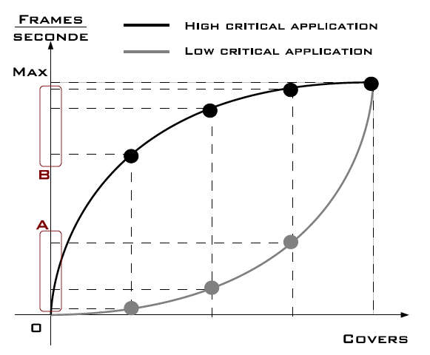
Criticality model (1)
Link the capture rate to the size of the coverset
High criticality
Convex shape
Most projections of x are close to the max capture speed
Low criticality
Concave shape
Most projections of x are close to the min capture speed
Concave and convex shapes automatically define sentry nodes in the network

Slide 10
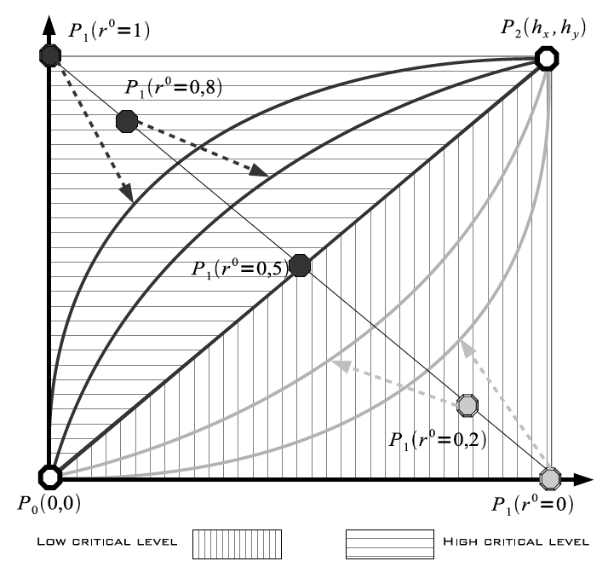
Criticality model (2)
r⁰ can vary in [0,1]
BehaVior functions (BV) defines the capture speed according to r⁰
r⁰ < 0.5
Concave shape BV
r⁰ > 0.5
Convex shape BV
We propose to use Bezier curves to model BV functions

Slide 11
Some typical capture speed
Set maximum capture speed: 6fps or 12fps for instance
Nodes with coverset size greater than N capture at the maximum speed
N=6
P₂(6,6)
N=12
P₂(12,3)

Slide 12
How to build an intrusion detection system
Static
Prior to deployment, define r° in [0,1] according to the application’s criticality
Risk-based
R⁰ is set initially low : R°_{min}
Some nodes serve as sentry nodes
On intrusion, increase R° to R°_{max} during an given alert period (Ta)
After Ta, go back to R°_{min}
2 variants
R° moves from R°_{min} to R°_{max} in one step
R° moves from R°_{min} to R°_{max} by reinforcement behavior

Slide 13
Risk-based scheduling in images (1)
R°=R°_{min}=0.1, R°_{max}=0.9, no alert
|Co(v_{j})|=3
fps=0.14
0.81
|Co(v_{i})|=8
0.14
fps=0.81
3
8

Slide 14
Risk-based scheduling in images (2)
R°➔R°=R°_{max}=0.9
|Co(v_{j})|=3
Fps=1.9
2.8
1.9
|Co(v_{i})|=8
Fps=2.8
3
8

Slide 15
Simulation settings
OMNET++ simulation model
Video nodes have communication range of 30m and depth of view of 25m, AoV is 36°. 150 sensors in an 75m.75m area.
Battery has 100 units, 1 image = 1 unit of battery consumed.
Max capture rate is 3fps. 12 levels of cover set.
Full coverage is defined as the region initially covered when all nodes are active

Slide 16
mean stealth time (MST)
t₁-t₀ is the intruder’s stealth time
velocity is set to 5m/s
t₀
t₁
intrusions starts at t=10s
when an intruder is seen, computes the stealth time, and starts a new intrusion until end of simulation

Slide 17
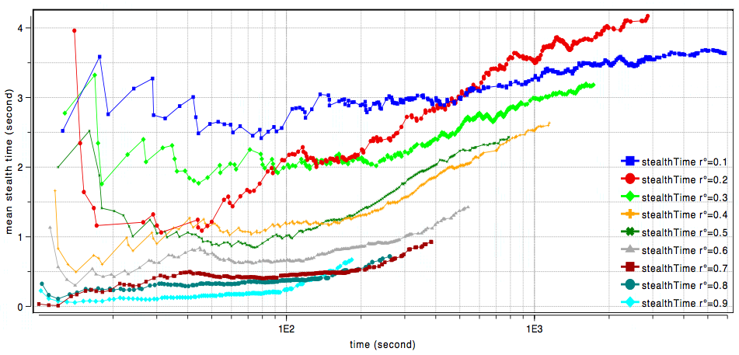
mean stealth time static scheduling

Slide 18
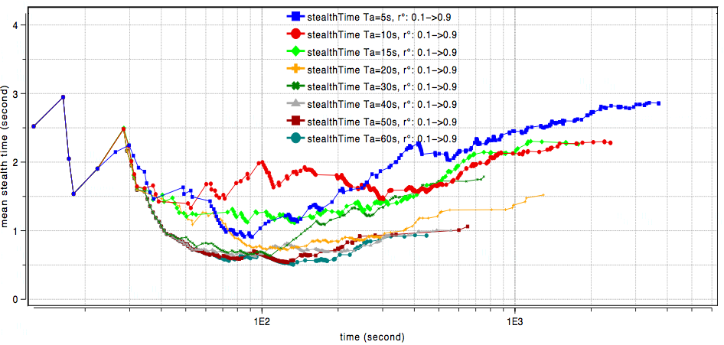
mean stealth time risk-based scheduling
450s
1300s
Sensor nodes start at 0.1 then increase to 0.9 if alerted (by intruders or neighbors) and stay alerted for Ta seconds

Slide 19
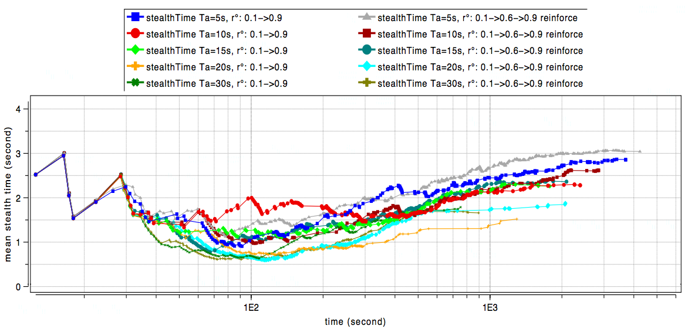
mean stealth time w/wo reinforcement
I_{r}=0.6
On alert 0.1➔I_{r}, then
2 alert msg I_{r}➔I_{r}+1
Until I_{r}=R°_{max}
Reinforcement always increases the network lifetime
Mean stealth time is close to the no-reinforcement case, especially when Ta>20s

Slide 20
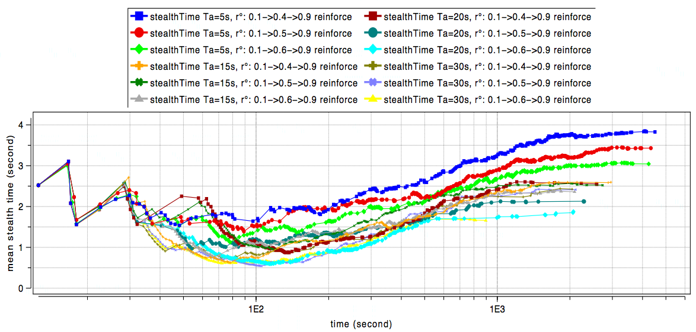
With reinforcement various initial threshold
I_{r}=0.4
I_{r}=0.5
I_{r}=0.6
Reduce I_{r} always increases the network lifetime
For small value of Ta, MST increase is noticeable
It is better to increase I_{r} than increase Ta.

Slide 21
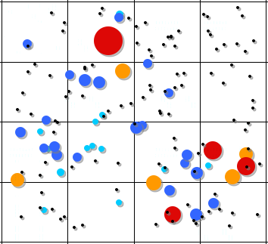
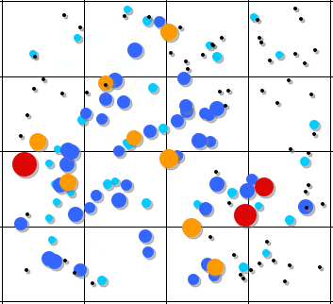
Sentry nodes
# of cover sets
# intrusion detected
0
<5
<10
<15
>15
0
<5
<10
<15
>15

Slide 22
Conclusions
Models the application’s criticality as bezier curves and schedules the video node capture rate according to the redundancy level
With this model, a risk-based scheduling can increase the network lifetime while maintaining a high level of service (mean stealth time)
Reinforcement behavior is beneficial and it is better to keep the alert period low <=20s for instance

